Slide 1
MATH 1010K Notes Section 1.1
Solving Problems by Inductive Reasoning
Distinguish between inductive and deductive reasoning.
Determine the most probable next term in a sequence of numbers.
Use the Method of Gauss to add a sequence of consecutive numbers.

Slide 2
Characteristics of Inductive and Deductive Reasoning
Inductive Reasoning (specific to general)
Specific examples are used to make a general conclusion – such as a pattern, formula, or model. Predicting other examples may also occur as a result.
Deductive Reasoning (general to specific)
A formula or model is used to create specific example(s). General principles are applied to specific examples.

Slide 3
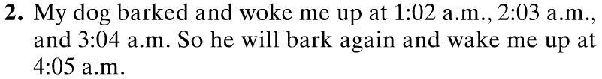
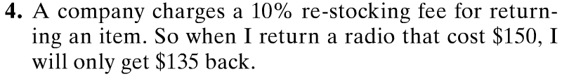
Determine if it’s Inductive or Deductive
Text, p. 6

Slide 4
Determine if it’s Inductive or Deductive
Text, p. 6
Inductive Reasoning – seeing a pattern from specific instances in order to predict a future instance.
Deductive Reasoning – formula is used to create specific example
Deductive Reasoning – given a general statement that is then applied to a specific situation

Slide 5
Determine if it’s Inductive or Deductive
Text, pp. 6 – 7
10. 7 + 37 = 44, 5 + 31 = 36, 17 + 29 = 46
Therefore, the sum of two prime numbers is even.

Slide 6
Determine if it’s Inductive or Deductive
Text, pp. 6 – 7
Inductive Reasoning – seeing a pattern from specific instances (B, B, B, B, B) in order to predict a future instance (6th = B)
10. 7 + 37 = 44, 5 + 31 = 36, 17 + 29 = 46
Therefore, the sum of two prime numbers is even.
Inductive Reasoning – seeing a pattern from specific examples to make a formula. (Note that in this case, the conclusion is INCORRECT – if you add 2, a prime number, to any other prime number, its sum is ODD, not even!)
Deductive Reasoning – given a general statement that is then applied to a specific situation

Slide 7
Example: Predicting the next number in a sequence (inductive reasoning)
Use inductive reasoning to determine the probable next number in the list below.
5, 9, 13, 17, 21, 25, 29

Slide 8
Example: Predicting the next number in a sequence (inductive reasoning)
Use inductive reasoning to determine the probable next number in the list below.
5, 9, 13, 17, 21, 25, 29
Solution
Each number in the list is obtained by adding 4 to the previous number.
The probable next number is 29 + 4 = 33.

Slide 9
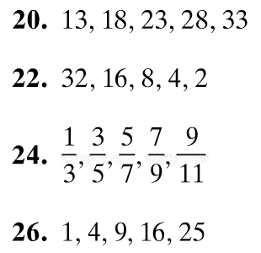
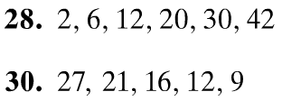
Determine the Most Probable Next Term (inductive reasoning)
Text, p. 7

Slide 10
Determine the Most Probable Next Term (inductive reasoning)
Text, p. 7
38
1
56
11 13
7
36
2

Slide 11
Let’s Consider This...
What is the sum of the first 100 counting numbers: 1 + 2 + 3 + ... + 98 + 99 + 100 ?
Assuming you take 1 second for each number and the plus sign, this would take you over a minute and a half just to input this on the calculator! What if you mistype a number or forget a plus sign? (Sigh). These errors do indeed happen with calculators – more often than you might think!
Hmmm...seems like I’m gonna need a calculator for this!

Slide 12
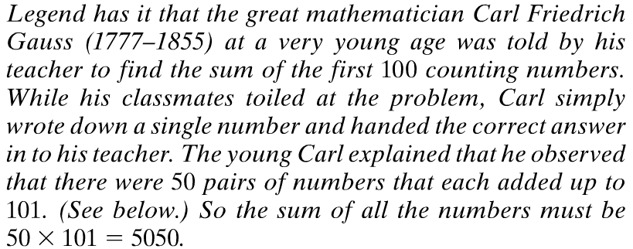
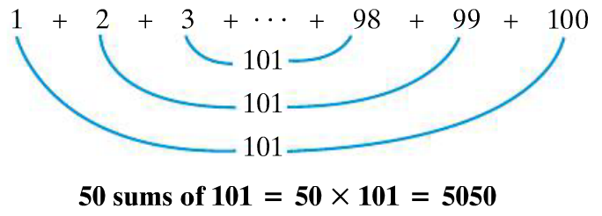
Using the Method of Gauss
Text, p. 8

Slide 13


Using the Method of Gauss
Text, p. 8

Slide 14
Using the Method of Gauss
Text, p. 8
Each pair-sum is 401. There are 400 ÷ 2 pairs = 200 pairs. So, the sum is 401 × 200 = 802,000.
Each pair-sum is 2001. There are 2000 ÷ 2 pairs = 1000 pairs. So, the sum is 2001 × 1000 = 2,001,000.

